Slide 1

GEOSPATIAL INTELLIGENCE BRIEFING · 2020–2025
Village Economic Growth Intelligence
Finding India’s 100 fastest-growing villages from space, 2020–2025
591,717
3
2
Arpita Hait
November 2026
villages screened
satellite signals
top-100 lists
Notes:
‹#›

Slide 2




FRAMEWORK & UNIT
What “growth” means here, and how we see it
Night lights · activity
NOAA VIIRS monthly radiance, ~500 m · median of each year, 2020 vs 2025
Built-up area · expansion
DEFINITION · IN GEOSPATIAL
Google/WRI Dynamic World land cover, 10 m · share of the village that is built, 2020 vs 2025
Economic growth is the spatially measurable expansion of local productive capacity, wealth, and infrastructure over time within rural boundaries
Building count · independent check
Unit: 591,717 Census 2011 villages
Window: 2020 → 2025 (5 years)
Google Open Buildings Temporal, 4 m · buildings per village, 2018 vs 2023 (data ends 2023)
Context: village boundaries and 2011 population from SHRUG (Census 2011) · distance to the nearest of 447 cities with 100,000+ people
Sources: NOAA/EOG VIIRS · Google & WRI Dynamic World · Google Research Open Buildings · Development Data Lab SHRUG
2
Notes:
‹#›

Slide 3
METHODOLOGY · TWO-STAGE SCREENING
From 648,878 polygons to two top-100 lists
648,878
591,717
401,430
388
2 × 100
Census 2011 village and town polygons (SHRUG)
villages after removing towns and places with no 2011 population
with 500+ people scored on lights + built-up (Stage 1)
shortlisted and checked with building counts (Stage 2)
top villages: overall, and rural (>10 km from a city)
Stage 1 score
Final score
Why two stages
Average of national percentiles: 50% night-light growth + 50% built-up growth. Light spikes with no construction (447 villages, e.g. gas flares) are excluded.
70% Stage 1 score + 30% building-growth percentile (2018 → 2023), within each shortlist of 250.
Building counts at 4 m are too time consuming for 591k villages; tested first on Haryana (6,681 villages).
Pipeline: notebooks 01 prepare → 02 extract (Google Earth Engine) → 03 score & rank → 04 visualise
3
Notes:
‹#›

Slide 4
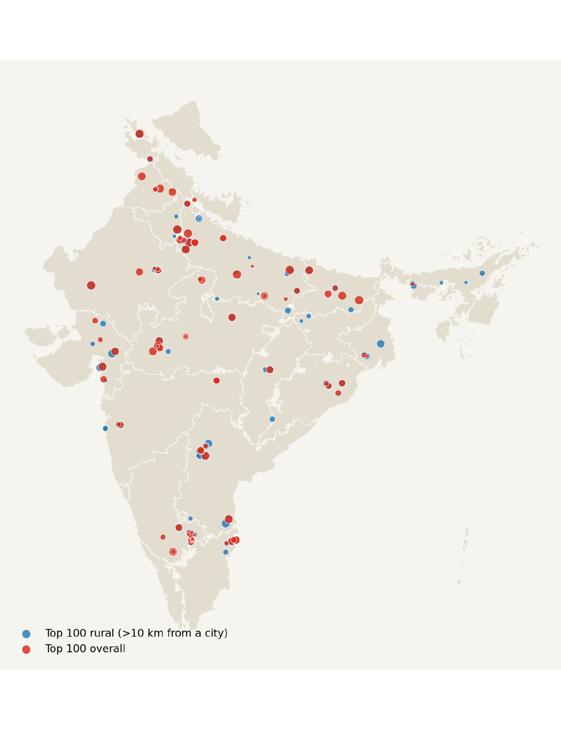

GEOGRAPHIC SPREAD & PROXIMITY
Where the fastest-growing villages are
61 / 100
6.7 km
39
overall leaders within 10 km of a 100k+ city
median distance to a city (rural list: 18.7 km)
villages on both lists
Red = top 100 overall · Blue = top 100 rural (>10 km from a city) · Interactive version: outputs/maps/top100_map.html
4
Notes:
Overall list, top states: Karnataka 24, Uttar Pradesh 16, Madhya Pradesh 11. Rural list, top states: Uttar Pradesh 17, Andhra Pradesh incl. Telangana 15, Rajasthan 11. Karnataka's count is likely driven by villages near Bengaluru – check nearest_city in the CSV.
‹#›

Slide 5
NATIONAL LEADERBOARD · TOP OVERALL
The leaders: all three signals rise together
# | Village | State | Night lights 2020 → 2025 | Built-up 2020 → 2025 | Buildings 2018 → 2023 | Nearest city
1 | Hajishahpur | Bihar | 2.5 → 8.2 | 0% → 56% | 0 → 68 | Bhagalpur, 1.5 km
2 | Kundal | Haryana | 1.7 → 14.3 | 1% → 29% | 6 → 111 | Bahadurgarh, 12.8 km
3 | Kashroul | Uttar Pradesh | 1.9 → 10.6 | 1% → 21% | 1 → 90 | Gorakhpur, 16.6 km
4 | Hora Kachhar | Uttar Pradesh | 5.6 → 14.1 | 3% → 59% | 21 → 362 | Kanpur, 0.5 km
5 | Sajiyali Roopji | Rajasthan | 5.4 → 68.1 | <1% → 22% | 205 → 3,177 | Jodhpur, 80.1 km
6 | Islamabad Kalda | Uttar Pradesh | 4.9 → 14.0 | 9% → 32% | 6 → 105 | Ghaziabad, 2.5 km
7 | Utar Pora Pahali Pora | Jammu & Kashmir | 0.8 → 3.5 | 7% → 31% | 16 → 186 | Anantnag, 23.5 km
Top 7 of the overall list · full tables: outputs/top100_villages.csv and top100_rural_villages.csv · lights in nW/cm²/sr
5
Notes:
Possible drivers to VERIFY with Google Earth historical imagery before claiming them: Banwari Bara (UP, rank 8) sits on the Noida International Airport (Jewar) site; Sajiyali Roopji (Rajasthan) is near the Pachpadra/Barmer refinery site; Sayakha (Gujarat, rural rank 7) matches a GIDC industrial estate near Bharuch; Imamguda (Telangana) is south of Hyderabad near the airport side. Hajishahpur (rank 1) is on the Ganga 1.5 km from Bhagalpur – built-up 0% to 56% with few buildings: check whether this is bridge/infrastructure works or river sand misread as built-up.
‹#›

Slide 6
VALIDATION · MULTI-SENSOR RECONCILIATION
Checking the ranking against independent evidence
90th
99%
0.06
percentile of building growth
Haryana pilot: the Stage 1 top 100 – chosen without building data – sits at the 89.8th percentile (50 = random).
of shortlisted villages gained buildings
388 villages, 2018 → 2023: median 533 → 819 buildings (+54%).
correlation, lights vs buildings
Haryana pilot: the signals capture different things, so no single one is enough.
Why lights alone mislead
Village | Lights | Built-up | Verdict
Disang Kinar Bangali, Assam | 1.2 → 125 | 4% → 4% | Excluded: likely gas flare
Konsari, Maharashtra | 0.4 → 22 | 6% → 24% | Kept: real expansion
Building counts: Google Open Buildings Temporal · Spearman correlation on 6,017 Haryana villages with 500+ people
6
Notes:
‹#›

Slide 7
RESEARCH GOVERNANCE & ROADMAP
Limitations and next steps
LIMITATIONS
NEXT STEPS
  Boundaries and population are from Census 2011; Telangana appears under Andhra Pradesh
  2020 was a COVID year, which may inflate light growth
  National run at 30 m (pilot 10 m) to fit the free compute quota
  Open Buildings ends in 2023, so its window is 2018 → 2023
  Night lights (~500 m) are coarse for small villages, and light is not income
  Land conversion (airports, plants) is not always local prosperity
  Verify the leaders with high-resolution before/after imagery
  Add Overture Places and Roads: businesses and road access as validation
  Test sensitivity to the weights, the 10 km threshold and minimum population
  Run building counts for every village with more compute quota
  Bring in ground data: GST registrations, bank branches, electricity connections
  Update to current district boundaries and names
Code, data sources and outputs: GitHub · arpitahait19/village-growth-intelligence
7
Notes:
‹#›

